Slide 1

A Learning method For Entity matching
Jie Chen, Cheqing Jin, Rong Zhang, Aoying Zhou
cqjin@sei.ecnu.edu.cn
East China Normal University

Slide 2
Outline
Introduction
Our Solution
Experiments
Conclusion

Slide 3
1. Introduction
In many applications, data is inaccurate, inconsistent and incomplete.
One entity may be represented by more than one (inconsistent) records.
Entity matching aims at finding record pairs referring to the same entity.

Slide 4
Example: (Four tuples from Cora dataset)
RID | Author | Title | Address | Date
1 | carla e. brodley and paul e. utgo. | multivariate versus univariate decision trees. | amherst ma | 1992.
2 | c. e. brodley and p. e. utgo. | multivariate decision trees. | amherst massachusetts | 1992.
3 | c. e. brodley and p. e. utgo. | multivariate decision trees. | NULL | 1995.
4 | carla e. brodley and paul e. utgo. | multivariate decision trees. | NULL | 1995.
same authors
same title
unspecified address
same date
[1, 2] Carla E. Brodley, Paul E. Utgoff. Multivariate versus univariate decision trees. Technical report, 1992
[3, 4] Carla E. Brodley, Paul E. Utgoff. Multivariate Decision trees. Machine learning 19(1):45-77, 1995
Generally, we can use a distance function, along with a threshold, to compare each tuple. When the distiance is below the threshold, the tuples refer to the same entity.

Slide 5
Challenges
How to select distance function for each attribute?
  i.e, which is better, Jaccard or edit?
How to set the threshold value for the distance function?
  i.e, what distance means similar, 0.2 or 0.4?
How to integrate multiple distance functions?
  i.e, is it possible to use Jaccard and edit simultaneously?

Slide 6
Related work
Classification-based Method
  By extracting feature vectors and training the classifiers
  effective, but often expensive
Rule-based Method
  By build rules to match records
  explainable and efficient
Our work belongs to the latter

Slide 7
2. Our solution
Training phase: general a model
  Step 1: Choose a metric to measure the appropriateness of a distance function
  Step 2: Compute the threshold value for that distance function
  Step 3: Integrate multiple distance functions and attributes
Testing phase: test the model

Slide 8
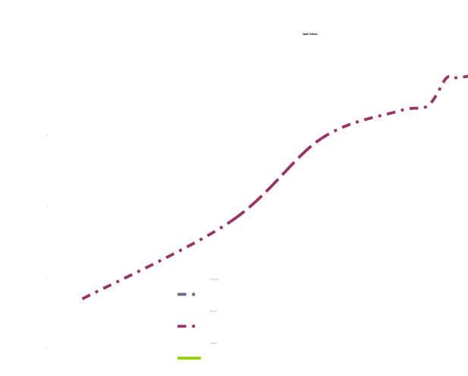
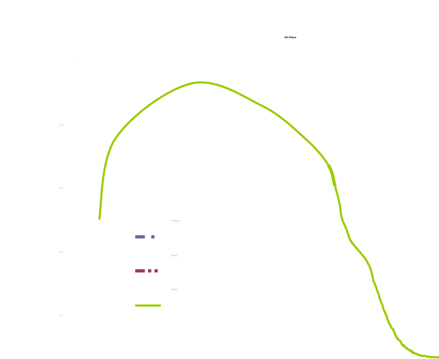
Step 1
# of correctly identified duplicate pairs
precision =
# of identified duplicate pairs
# of correctly identified duplicate pairs
recall =
# of true duplicate pairs
2 * precision * recall
F-score =
precision + recall
Note: it is easy to extend to the biased F-score.

Slide 9
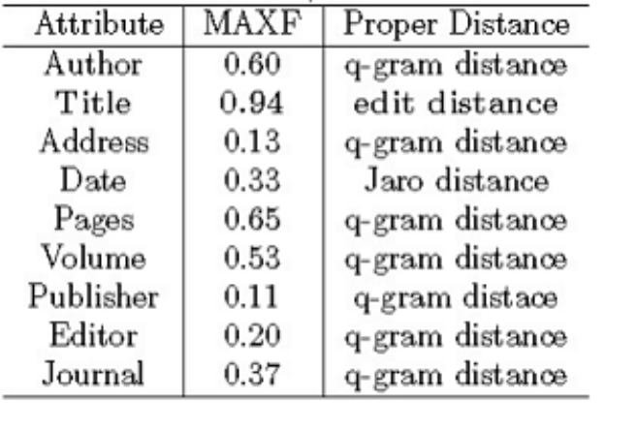
Step 1
Definition1 (Attribute-level maximum F-score)
MAXF_{A}(E) = max_{dis∈D}(MAXF_{dis, A}(E))
A distance function set
An attribute
A distance function
A relation
Detail steps:
maxfa = 0;
for each attribute A
for each distance function dis
compute MAXF_{A}(E);
if (MAXF_{A}(E) > maxfa
maxfa = MAXF_{A}(E)
return A and E that has maxfa value

Slide 10
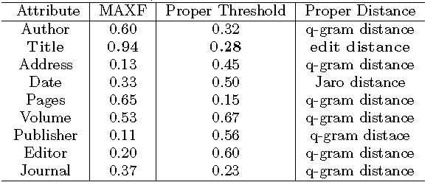
Step 2: compute the proper threshold for MAXF(E)
max_{A}(MAXF_{A}(E))
The edit distance is normalized to [0, 1]
Conclusion: We can claim that a pair of records belong to the same entity if the edit distance of title attribute is smaller than 0.28

Slide 11

Step 3: How about using multiple attributes?
It is better to use multiple attributes to measure the distance between a pair of tuples.
Hint: Given an attribute group G, we use a weighted metric, GD, to measure the distance between a pair of tuples e_{i} and e_{j}
weight
the proper distance over single attribute

Slide 12
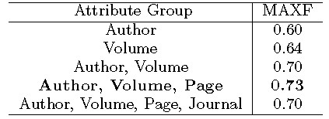
Step 3
Using more attributes may either increase, or decrease the MAXF value.
{Author, volume, page} is better than the rest groups.
However, finding the proper group needs to check all attribute combinations, which is expensive to execute.
Hence, we provide a heuristic solution.

Slide 13
Step 3: Heuristic solution
Let S_{h} denote a set containing all attribute groups with a size of h.
1. Initially, generate S₁ containing all single-attribute groups;
2. Iteratively generate S_{h} by using S_{h-1} and S₁;
3. Each element G in S_{h} should be superior to any element in S_{h-1} or S₁.
Assume G'∈S_{h-1}, G''∈S₁, G=G'∪G''
MAXF_{G} > max( MAXF_{G'}, MAXF_{G''})
Performance Analysis:
1. Efficient to execute
2. May not find the optimal attribute-group.
3. Experimental results run well

Slide 14
3. Experiments
Data sets
  Cora is a collection of 1876 citation entries
    Attributes(9): author, title, address, date, page, volume, publisher, editor and journal.
  Restaurant is a collection of 191 restaurant records
    Attributes(4): name, address, city and type.

Slide 15
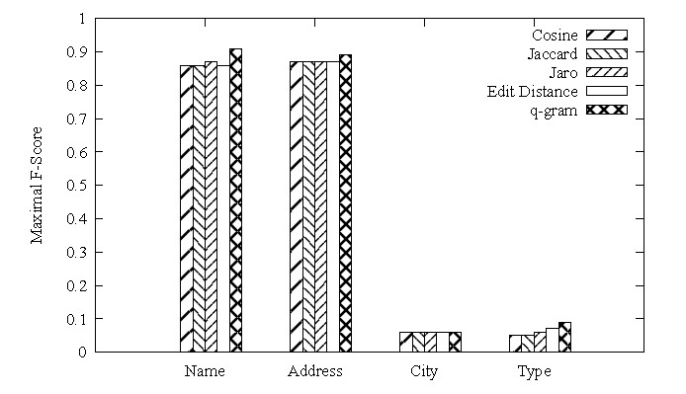
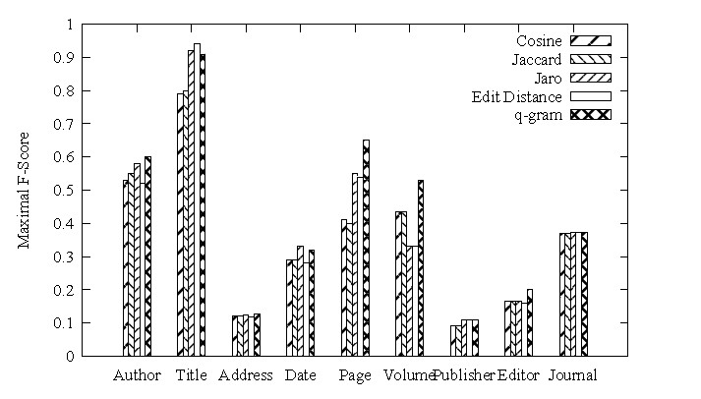
3. Experiments
1. Single-attribute test
Restaurant data set
Cora data set

Slide 16
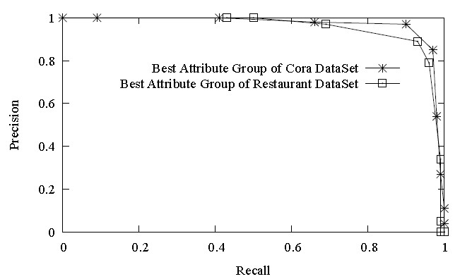
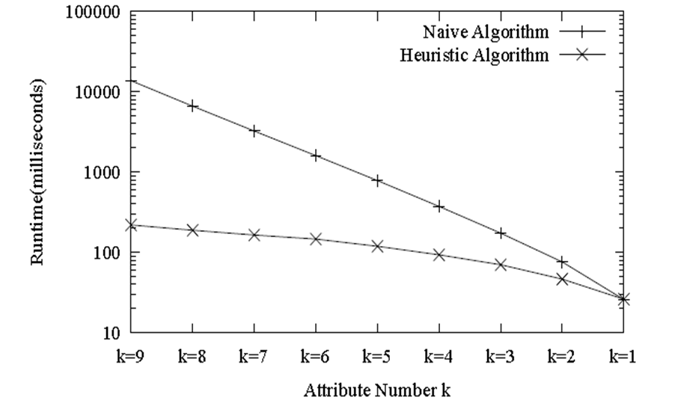
3. Experiments
2. Attribute group test
The Recall-Precision Curve under the best attribute group
Performance of the heuristic solution

Slide 17
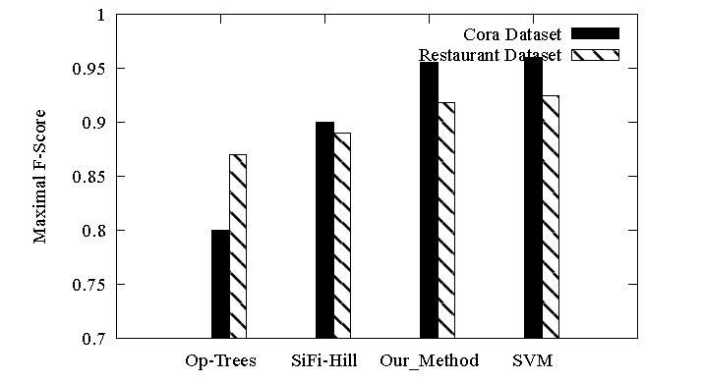
3. Experiments
Comparison with Existing Techniques
  Op-tree: not consider the redundancy among similarity functions
  SiFi: highly dependent on given rules

Slide 18
4. Conclusion
This paper aims at selecting an appropriate distance function, rather than proposing a new distance function.
Unnecessary to define the threhold parameter.
A heuristic approach to for higher efficiency.
Evaluated by real data sets.

Slide 19
Questions?

